Slide 1
ENGR 400/LENGR 400 ETHICS IN ENGINEERING AND SCIENCE
Chapter 5
Risk, Safety, and Accidents
ORAL ANSEN

Slide 2
Chapter 5 Outline
Engineering and Risk
Engineering and Risk Management
Failure Mode Analysis Methods
Fault-Tree Analysis
Event-Tree Analysis
Engineering and Acceptable Risk
Approaches to Acceptable Risk
Engineering and Safety
Engineering and Safe Design
Engineering and Accidents

Slide 3
Engineering and Risk
Risk and problem differentiation
Problems exist today and may be the result of past decisions (or omissions)
Risks are potential future problems which may happen as a result of decisions taken today

Slide 4
Engineering and Risk
Engineering necessarily involves risk
Technology imposes risk on the public
New hazards could be found in products, processes, and chemicals that were once thought to be safe
Engineers are constantly involved in innovation
New machines are created and new compounds synthesized always without full knowledge of their long-term effects on humans or the environment

Slide 5
Engineering and Risk
Risk perception is the subjective judgment people make about the severity and probability of a risk, and may vary from person to person
Values such as financial wealth, physical health, social status, or emotional well-being can be gained or lost when taking risk resulting from a decision – action or inaction

Slide 6
Engineering and Risk
Risk is defined as:
Traditionally
“uncertainty concerning the occurrence of a loss”, or
‘‘the chance of occurrence of an undesired event and the severity of the resulting consequences’’
According to ISO Guide 73
“effect of uncertainty on objectives”
In engineering
Risk = (probability of event) x (consequences)
Probability: The chance or the likelihood of occurrence of an undesired event

Slide 7
Engineering and Risk
Estimating risk is an uncertain prediction of the probability and severity of harm
In actual practice, it is difficult to estimate risk, often we cannot even make our estimate with accuracy
If we could accurately predict the harm resulting from engineering work, we would know precisely the harm to expect

Slide 8
Engineering and Risk
Engineering work can subject people to risks, therefore to harm
Harm is an act that causes physical or other injury or damage – a limitation of a person's physical, psychological, economic well-being
For example;
faulty design of a building can cause it to collapse, resulting in economic loss to the owner and perhaps death for the inhabitants
faulty design of a chemical plant can cause accidents, death of people and economic disaster

Slide 9
Engineering and Risk
Human error is also a risk in engineering, as in any other profession
Human error means that something has been done;
that was not intended by the actor,
that was not desired by a set of rules, or
that led the task or system outside its acceptable limits

Slide 10
Engineering and Risk Management
Risk management is the process of
identification,
analysis,
assessment,
the process of qualitative risk categorization or quantitative risk estimation,
control, and avoidance, or minimization of unacceptable risks

Slide 11
Engineering and Risk Management
Risk management in engineering involves mainly:
Thinking systematically about all possible risks, harms, or undesirable outcomes before they happen
Using best of your knowledge, experience and skill for eliminating, or minimizing them primarily in the design phase, or in production

Slide 12
Failure Mode
Failure mode in engineering is a major source of risk, which must be managed
‘‘Failure mode’’ is defined as a way in which a structure, mechanism or process can malfunction
For example; a system in failure mode may be characterized by
slow operation, or
incorrect outputs, or
complete stop of operation

Slide 13
Failure Mode Analysis
Failure mode analysis is the process of collecting and analyzing data to identify;
failure mechanism,
cause of failure, and
consequences of failure
It is an important discipline used in many branches of engineering

Slide 14
Failure Mode Analysis Methods
Most commonly used two methods for failure mode analysis:
Fault-Tree Analysis (FTA)
Event-Tree Analysis (ETA)

Slide 15
Failure Mode Analysis Methods
These two methods approach from the opposite sides of an undesired event
FTA focuses on the possible causes leading to an undesired event
ETA focuses on the possible consequences after an undesired event occurs

Slide 16
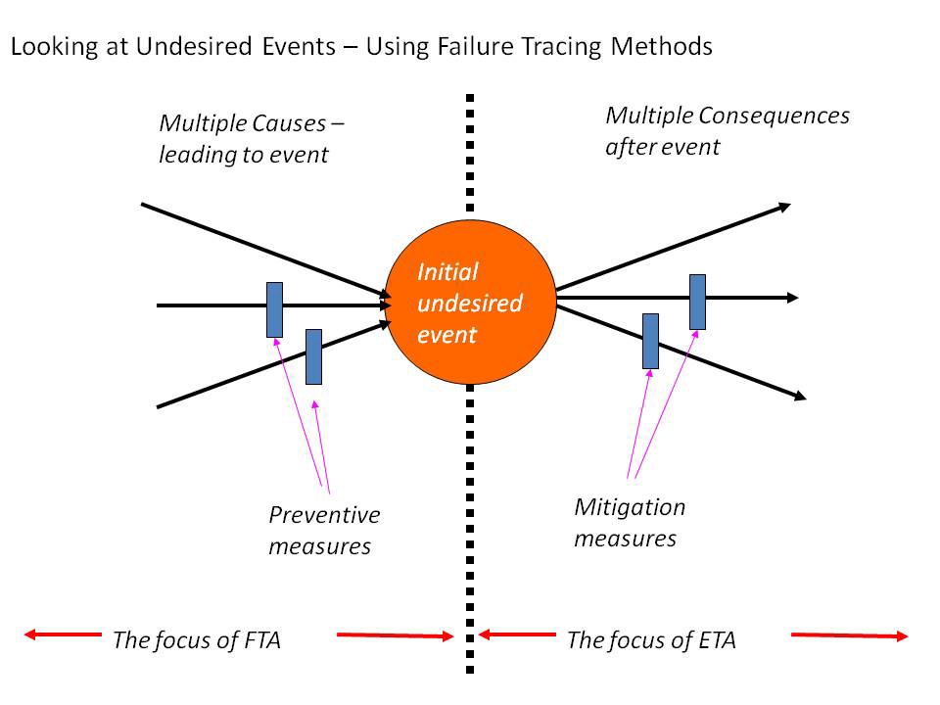
Comparison Diagram for FTA and ETA

Slide 17
Fault-Tree Analysis
Fault-tree analysis is a logical diagram of the possible causes by which a malfunction or accident can occur
In a fault-tree analysis one starts with an undesirable event, and then reasons backward to determine what might have led to that event
It enables an engineer to analyze in a systematic and stylized logical process the various failure modes present at an engineering project
Notes:
Page 127
1. Used in both reliability engineering and system safety engineering
(More well known in reliability)
2. Developed in 1961 for US ICBM program
3. Guide published in 1981
Published by US Nuclear Regulatory Commission
4. Used in almost every engineering discipline
From Mass Transit to commercial nuclear power plants
Chemical process plants
Oil drilling platforms
NASA satellites
Aircraft control centers
Used to recreate events leading up to Challenger accident
5. Not a model of all system or component failures
It is a model of particular system failure modes
Can be events associated with any element that makes up the complete
system

Slide 18
Fault-Tree Analysis
Can be used almost in every engineering field especially in reliability engineering and system safety engineering

Slide 19
Fault-Tree Analysis Steps
An undesired event is defined
The event is resolved into its immediate causes
This resolution of events continues until basic causes are identified
Fault tree is constructed in the process of carrying out the analysis

Slide 20
Fault-Tree Analysis Symbols
Primary Event Symbols
Gate Symbols
Basic Event
AND
OR
Conditioning Event
Exclusive OR
Undeveloped Event
Priority AND
External Event
Inhibit
Intermediate Event Symbol
Transfer Symbols
Transfer IN
Transfer OUT

Slide 21
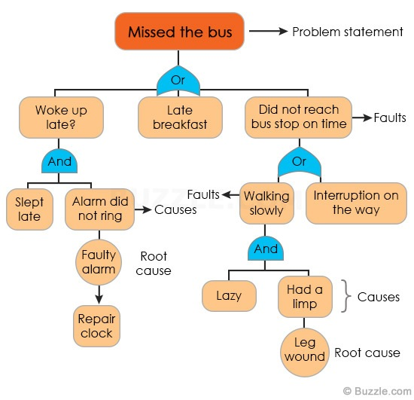
Example: Fault-Tree Analysis

Slide 22
Example: Fault-Tree Analysis
Failure of an Automobile to Start

Slide 23
Event-Tree Analysis
An event-tree analysis is a logical diagram of the potential consequences that can result from a specific system failure, equipment failure, or human error
Used in;
analyzing the effect of safety systems or emergency procedures on accident prevention or mitigation
during the definition, design, modification, or operation phase of a system

Slide 24
Event-Tree Analysis Steps
Identify an initiating undesired event; may be a system failure, equipment failure, or human error
Identify the safety functions designed to deal with the initiating event; an automatic emergency shutdown, alarms to alert operators, etc.
Describe the variety of consequences that could occur following the initiating event
Construct the event tree

Slide 25
FTA and ETA
In fact these two methods are complimentary and are often used together in the analysis of a failure

Slide 26
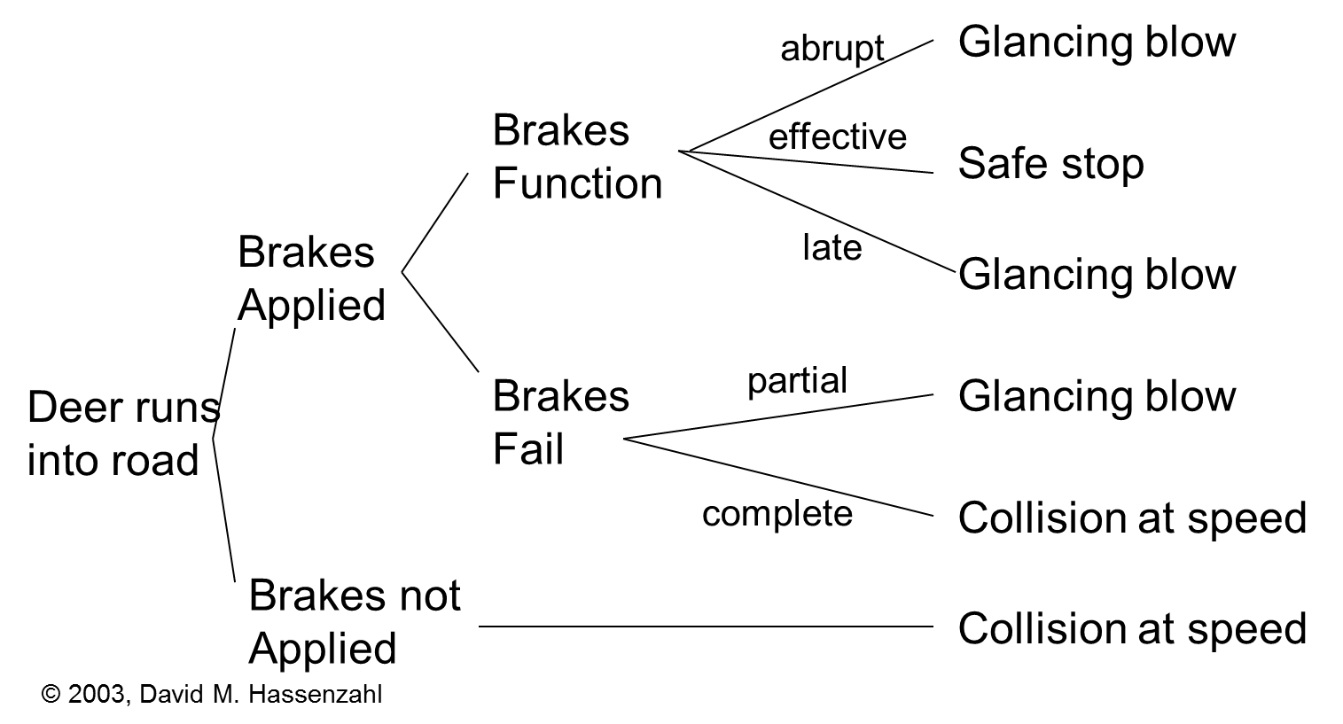
Example: FTA and ETA
Deer in Road
Fault-Tree Analysis

Slide 27
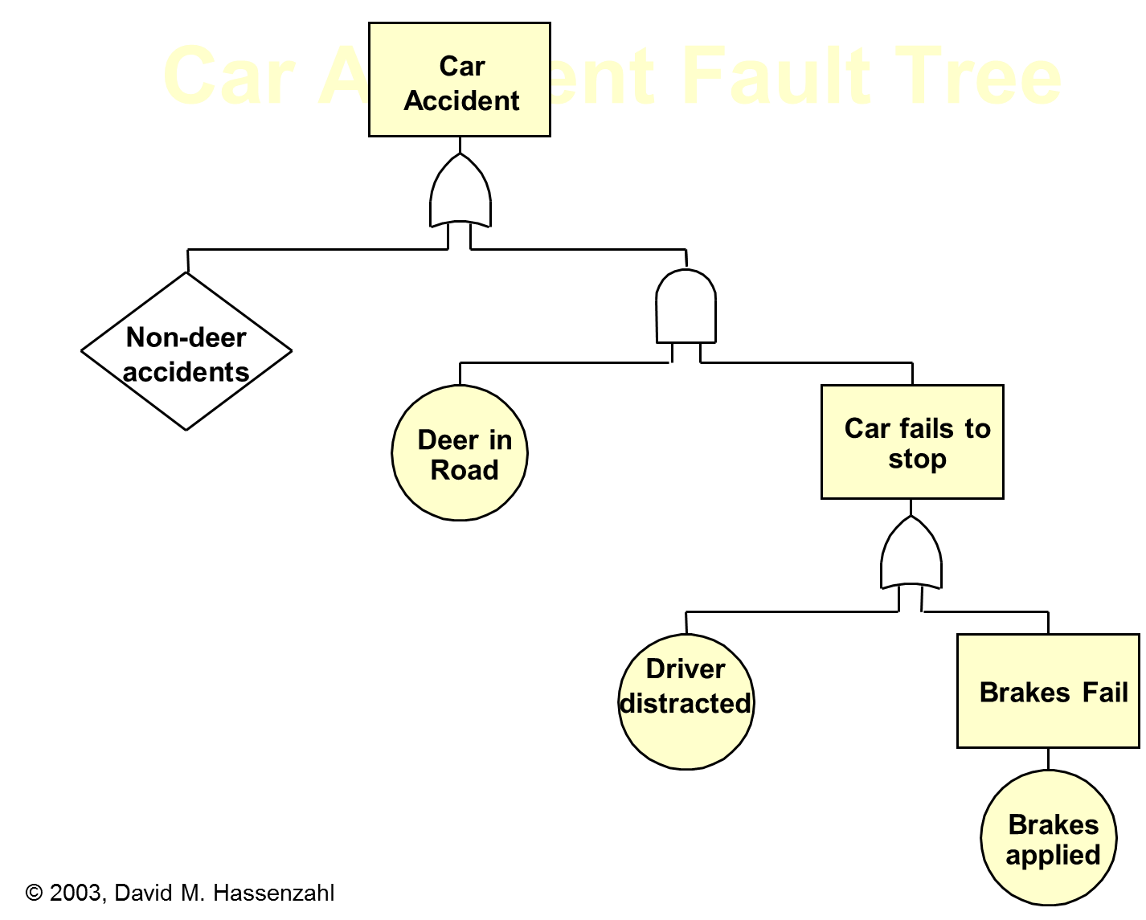
Example: FTA and ETA
Deer in Road
Event-Tree Analysis

Slide 28
Engineering and Acceptable Risk
There is an important concept in engineering called “acceptable risk”
William D. Rowe says that:
“A risk is acceptable when those affected are generally no longer (or not) apprehensive (anxious) about it”
Although risks are sometimes difficult to detect and eliminate, however, there are possibilities of reducing risk to acceptable levels

Slide 29
Engineering and Acceptable Risk
To reduce risk to acceptable levels;
develop inherently low-risk designs,
design for failure modes that give warning before catastrophic failure
Many engineering failures involve, at least in part, “an operations or structural failure”
Next slide shows the basic reasons of engineering structural failure

Slide 30
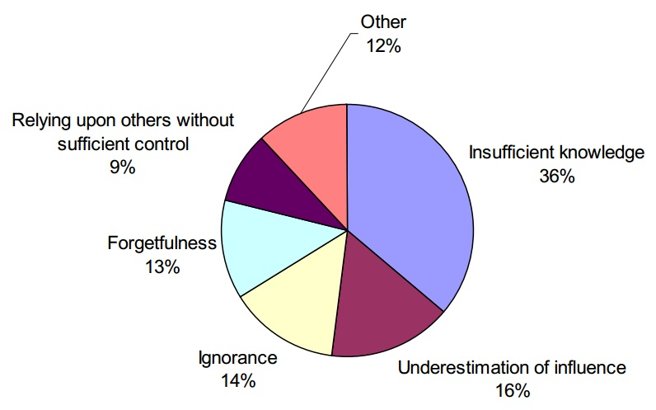
The Reasons of Engineering Structural Failure

Slide 31
Approaches to Acceptable Risk
Expert’s Approach
Layperson’s (common person’s) Approach
Government Regulator’s Approach

Slide 32
Expert’s Approach to Acceptable Risk
Expert’s approach to acceptable risk is usually utilitarian
The answer to any moral question is to be found by determining the course of action that maximizes well-being

Slide 33
Expert’s Approach to Acceptable Risk
For assessment experts generally make use of cost-benefit analysis converted into risk-benefit analysis
Here cost is measured in terms of risk of deaths, injuries, or other harms associated with a given course of action
But cost-benefit analysis has some limitations
It is not always possible to translate all of the risks and benefits into monetary terms
What is the monetary value of human life?

Slide 34
Layperson’s Approach to Acceptable Risk
Layperson (common person) understand risk differently than risk experts;
often overestimate, or underestimate severity of risks,
more closely follows respect-for-persons approach than the utilitarian approaches used by many experts
According to layperson (common person); acceptable risk is one in which risk is;
freely assumed by free and informed consent,
justly distributed,
properly compensated

Slide 35
Example: Neighborhood Nuclear Power Plant
The electric power company proposes to build a nuclear power plant near your neighborhood
The power probably will be sold out of state to electricity market network because prices are higher there

Slide 36
Example: Neighborhood Nuclear Power Plant
Layperson’s key questions of evaluation:
Is the risk voluntary?
Yes, within the limits of the democratic process
Does the person assuming the risk understand it?
No, the general public does not understand nuclear energy
Does the person assuming the risk have control?
No, the power company controls the plant
Is the risk distributed equitably?
No, those living close to the plant take a higher risk
Are those assuming the risk compensated?
No, the power is sold to out of state

Slide 37
The Government Regulator’s Approach to Acceptable Risk
According to government regulators; acceptable risk is one in which protecting the public from harm has been weighed more heavily than benefiting the public

Slide 38
The Three Approaches to Acceptable Risk Compared
Risk expert: Wants to balance risk and benefit in a way that optimizes public well-being
Layperson: Wants to protect himself/herself from risk
The government regulator: Wants as much assurance as possible that the public is not being exposed to unexpected harm

Slide 39
Engineering and Safety
Safety: Relative freedom from danger, risk, or threat of harm, injury, damage, or loss to personnel and/or property
http://www.businessdictionary.com/definition/safety.html
Concept of safety: “A thing is safe if its risks are judged to be acceptable.”
William W. Lowrance
Reliability: The ability of an item to perform its intended function under stated conditions for a specified period of time

Slide 40
Engineering and Safety
What may be safe enough for one person may not be safe for someone else, for example:
A scissors in the hands of a child will never be as safe as it can be in the hands of an adult
A sick or small baby is more liable to suffer from air pollution than is a healthy adult

Slide 41
Engineering and Safety
No duty of the engineer is more important than to protect the safety and well-being of the public as per Chapter-2, engineering codes of ethics:
Engineers must hold paramount the safety, health, and welfare of the public
Engineers are required to prevent exposure of the public to unacceptable risks
In practice, nothing can be 100% safe, but engineers are required to make their designs as safe as reasonably possible

Slide 42
Engineering and Safe Design
Spending a long time for designing a safer product may seem like a very expensive issue, especially in design stage
The wise and ethical thing to do is to spend as much time and expense as possible up front to engineer the design correctly, so as to minimize any future risk of harm and subsequent criminal or civil actions against you

Slide 43
Engineering and Safe Design
There are six conditions that must be met by engineers to help ensure safe design:
The minimum requirement is that a design must comply with the applicable laws
Legal standards for product safety are generally well known, are published, and are easily accessible
A design must meet the standards of “Accepted Engineering Practice” and appropriate “Factor of Safety”
Potentially safer alternative designs must be explored

Slide 44
Engineering and Safe Design
Incorporate redundancy in design
Redundancy is a system design in which a component is duplicated so if it fails there will be a backup
Engineers must try to foresee consumers possible misuse of the product and should design the product to avoid such misuses
Once the product is designed, both prototypes and finished products must be tested to check if the product is safe before it is manufactured and marketed

Slide 45
Example: Kursk Submarine Disaster
Kursk submarine disaster illustrate the importance of adequate testing
The Kursk was a Russian navy nuclear-powered cruise-missile submarine that sank in the Barents Sea in northern Russia on 12 Aug. 2000
The sinking has been attributed to an explosion in the torpedo room that ripped open a large hole in the hull
All 118 crewmen died on the bottom of the sea, mostly due to the lack of safety measures aboard and the total lack of preparation for emergency situations by the authorities

Slide 46
Example: Kursk Submarine Disaster
Apparently, one of the torpedoes aboard the Kursk was damaged during transport and it was leaking fuel
This particular torpedo wasn’t armed with warheads and the inspection gave it little attention, but noticed the leakage
The officers neglected the malfunction, for the exercise was a top priority, and it had to be conducted on schedule
The fuel leakage led to the initial explosion
The fire triggered set off a second explosion of five to seven combat-ready torpedo warheads

Slide 47
Example: Kursk Submarine Disaster
Many crew members of the Kursk survived the initial explosion, but died because they were unable to escape from the submarine, and no attempts of rescue were successful
The Time Magazine June 3, 2002 edition reported that Russian naval engineers say that the Kursk was equipped with a rescue capsule designed to allow crew members to float safely to the surface in an emergency
However, in the rush to get the submarine into service, this safety system was never tested

Slide 48
Example: Kursk Submarine Disaster
After the accident, some of the survivors attempted to rescue themselves by using this system, but it did not function properly
Conclusion: It is essential that in any engineering design, all safety systems be tested to ensure that they work as intended

Slide 49
Example: Computer-Related Risks
The baggage-handling system of the Denver International Airport
Errors in the software that controls the baggage-handling system required postponement of the official opening of the airport on Oct. 1993
By June 1994 the $ 193 million system was still not functioning, but costing $ 1.1 million per day in interest and other costs
In early 1995 a manual baggage system was installed in order to open the airport

Slide 50
Example: Computer-Related Risks
The Ariadne rocket, a common European space project exploded a few seconds after takeoff, due to a software error
Some cancer patients in the USA have received fatal radiation overdoses from the Therac-25, a computer-controlled radiation-therapy machine
…

Slide 51
Example: The Quebec Bridge Collapse
The Quebec Bridge is the longest cantilever span in the world with two main supports placed 549m apart over St. Lawrence River
Quebec Bridge Company employed;
a chief engineer, Edward Hoare,
an erection inspector, Norman McLure, and
a consulting engineer, Theodore Cooper who was seen as an expert in his field
http://ethics.wikia.com/wiki/The_Quebec_Bridge_Collapse

Slide 52
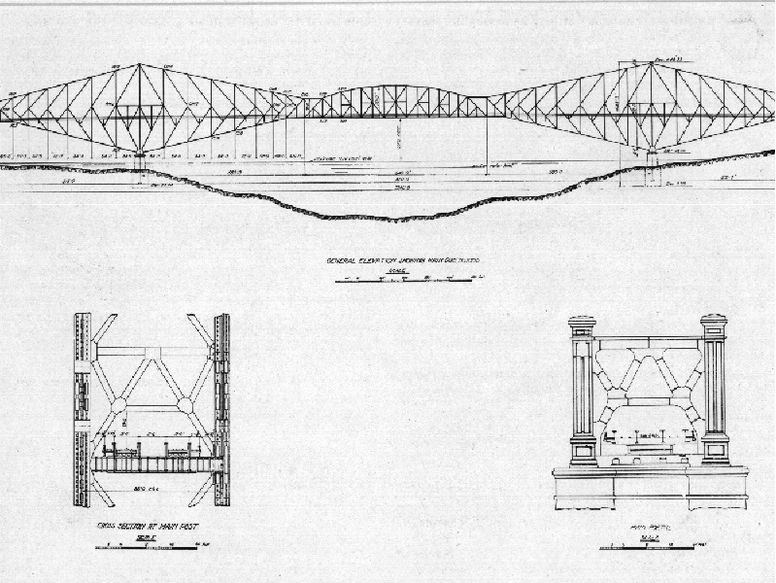
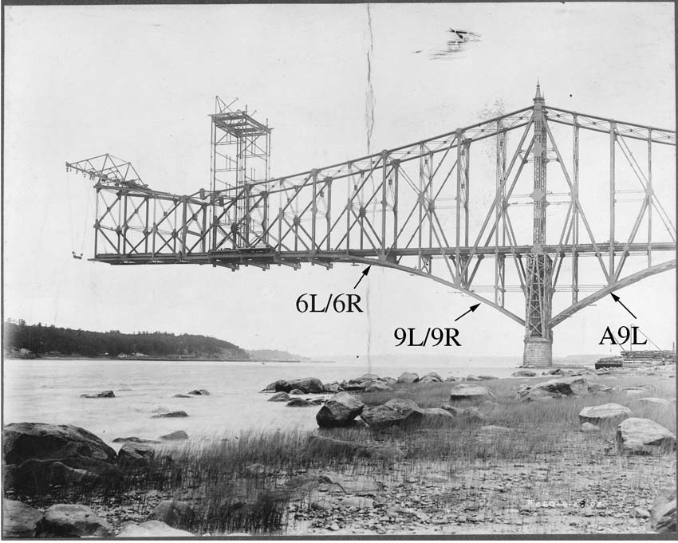
Example: The Quebec Bridge Collapse
Source: The Quebec Bridge Collapse August 29, 1907 by Dan Ford

Slide 53
Example: The Quebec Bridge Collapse
Due to Cooper’s health issues he only visited the site of the bridge 3 times
This left a lack of authority on the construction site
The actual weight of steel put into the bridge had far exceeded the original weight

Slide 54
Example: The Quebec Bridge Collapse
In 1907, the first span of the cantilever reached over the water, and it became clear to McLure that certain steel chords were beginning to bend
He sent a letter to Cooper, who sent a telegraph to the Phoenix Bridge Company to “add no more load to the bridge till after due consideration of facts”, but McLure restarted construction

Slide 55
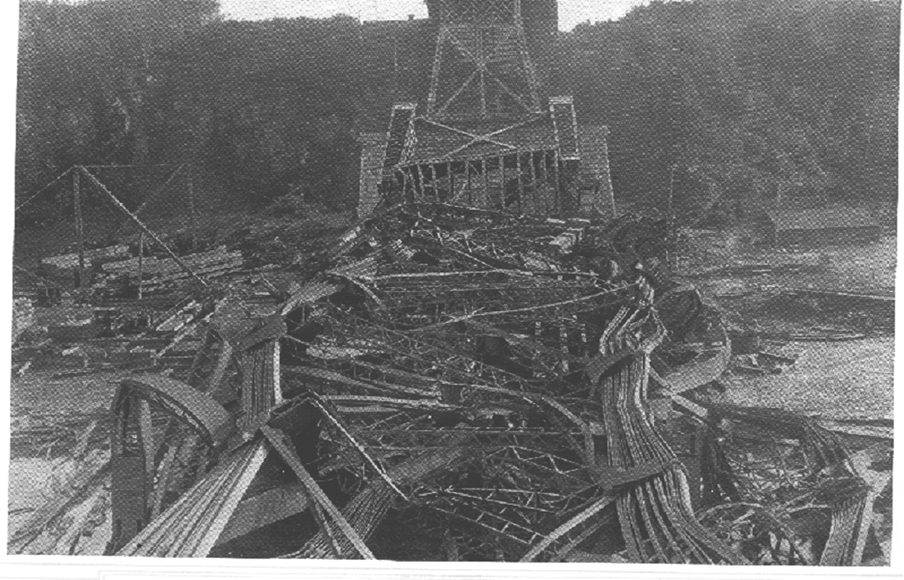
Example: The Quebec Bridge Collapse
At the end of the work day on August 29, 1907, the bridge collapsed killing 75 of the 86 workers on the bridge

Slide 56
Example: The Quebec Bridge Collapse
A Royal Commission was assembled to investigate the cause of the collapse, and the majority of the blame was on;
Cooper, who was at fault for not knowing what was happening at the worksite, and for miscalculations, and
Hoare should not have been appointed as the chief engineer because he lacked technical competence to control the work
Communication and organization were also blamed

Slide 57
Example: The Quebec Bridge Collapse
The bridge was rebuilt, and on September 11, 1916 the bridge collapsed again killing 13 men
From an investigation by the St. Lawrence Bridge Company, the collapse was due to a material failure in one of the four bearing castings that supported the central span

Slide 58
Example: The Quebec Bridge Collapse
These collapses were the driving force in regulating the engineering profession
If you ever meet an engineering graduate of a Canadian university, take a look at the little finger of their writing hand
In all likelihood, they will be wearing a plain iron ring
The iron ring is rumored to be made of the steel that collapsed, to remind engineers of their importance and their duty

Slide 59
Example: The Quebec Bridge Collapse
Some lessons learned by this collapse include:
Assigning tasks only to capable engineers with responsibility
Paying engineers appropriately for their work
Defining duties clearly for employees
Discussing design plans in groups
Coordinating and communicating effectively
Making sure the work is controlled and monitored regularly

Slide 60
Engineering and Accidents
Accident is defined as an unplanned and uncontrolled event that results in damage to life, property and environment
When an accident occurs, it should be thorough investigated and the reports issued should be published and circulated to related parties

Slide 61
Engineering and Accidents
There are many ways in which accidents can be categorized and studied
One of them categorize accidents into three types:
Procedural accidents
Engineered accidents
Systemic accidents
Langewiesche, 1998

Slide 62
Types of Accidents
Procedural accidents (most common)
Caused by
human error, or
not following the prescribed procedure, or
following an incorrect procedure
Engineered accidents
Caused by
errors in design, and
failures of materials and devices that don’t perform as expected

Slide 63
Types of Accidents
Systemic accidents
Caused by failures in any component of especially complex systems
Two characteristics of high-risk technologies make them susceptible to accidents;
Tight Coupling
Complex Interactions
of the parts of a technological system
Examples of tightly coupled and complexly interactive technical systems: Integrated chemical plants, nuclear power plants, space missions, nuclear weapon systems, etc.

Slide 64
Engineering and Accidents
Two characteristics of high-risk technologies make them susceptible to accidents;
Tight Coupling
Complex Interactions
of the parts of a technological system
Examples of tightly coupled and complexly interactive technical systems: Integrated chemical plants, nuclear power plants, space missions, nuclear weapon systems, etc.

Slide 65
Tight Coupling
Systems are said to be tightly coupled when a failure in one system can adversely and rapidly affect operations in another system
Such systems can have unexpected failures, usually little time to correct a failure and little likelihood of confining a failure to one part of the system, so the whole system is damaged (systemic accidents)

Slide 66
Complex Interactions
Processes are complexly interactive, if the parts of the system can interact in unanticipated ways
Complex systems not only make accidents likely, but also difficult to predict and harder to control
Like no one expected that when part X failed it would affect part Y
Example: Petro-chemical plants are also complexly interactive in that; parts affect one another in feedback patterns that cannot always be anticipated

Slide 67
Normalization of Deviance
Engineers increase the risk to the public by allowing increasing numbers of deviations from proper standards of safety and acceptable risk, which is called normalization of deviance (deviations)
Sometimes people become so much accustomed to a deviant behavior that they don't consider it as deviant, despite the fact that they far exceed their own rules for the elementary safety in their own lives
But, this creates accidents

Slide 68
Normalization of Deviance
Vaughan says that actions that have always been thought of as “not okay” are slowly reclassified as “okay” over a period of time, through a gradual cultural shift
http://www.decisionstrategies.com/normalization-of-deviance/
Accepting anomalies (abnormalities) instead of attempting to correct a design or operating conditions make accidents inevitable!

Slide 69
Examples
Challenger Disaster
The loss of the Space Shuttle Challenger is an example of an engineering system failure due to operations failure
NASA’s proceeding with the Challenger launch despite problems about freezing O-rings
The practice of “Normalizing Deviations”, that is the acceptance of anomalies (unexplained leakages of the O-ring seals) in previous flights led to continued operation of a system that was dangerously close to its safe limit of operation
Also, operational limits (low launch temperature) were increased without appropriate study

Slide 70
Examples
Challenger Disaster – cont’d
Main lesson learned from Challenger
Pay attention and care early warning signs of problems
Avoid “normalization of deviance”
Ford’s refusal to recall Pintos with exploding gas tanks in the 1970s
Volkswagen’s decision to intentionally cheat on emissions testing in order to sell more cars
You cannot unconsciously install a ‘‘defeat device’’ into hundreds of thousands of cars
http://www.decisionstrategies.com/normalization-of-deviance/

